Slide 1
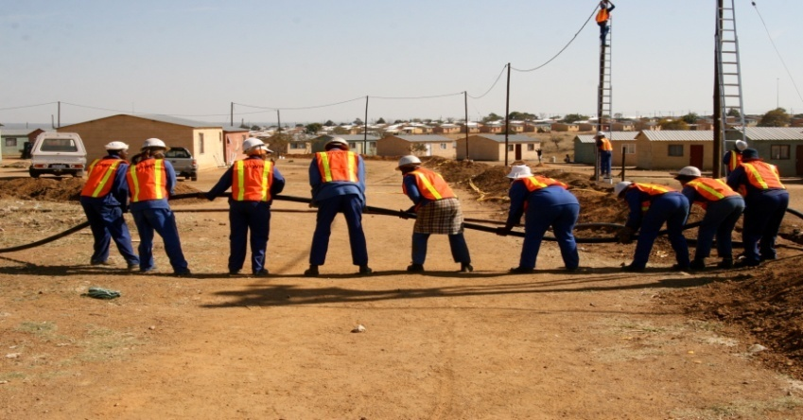
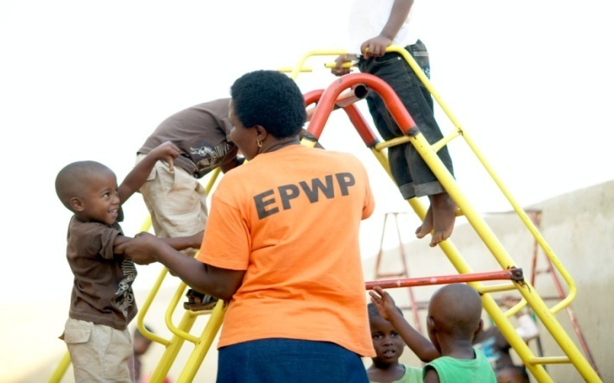
Expanded Public Works Programme 2018 Summit Commission 2: Sustainable Livelihoods, Convergence, with embedded exit strategies

Slide 2
Sustainable Livelihoods
A livelihood is sustainable when it can cope with and recover from the stresses and shocks and maintain or enhance its capabilities and assets both now and in the future without undermining the natural resource base (Chambers & Conway).
A livelihood is sustainable when it can cope with and recover from stresses and shocks and maintain or enhance its capabilities and assets both now and in the future [DFID].
It is not just about the means to survive, but the capability to thrive.

Slide 3
Sustainable Livelihoods Assets Pillars
Human Capital
Social
Capital
Natural
Capital
The Poor
Physical
Capital
Financial
Capital
3

Slide 4
EPWP Sustainable Livelihood Interventions and The 5 Pillars
Dimensions of EPWP’s development impact
Financial Capital - e.g. Improve the vulnerability context of participants through income transfer
Human Capital – e.g. Enhance skills for future employability
Social Capital – e.g. Establish Community safety Forums, fair recruitment processes
Physical Capital – e.g. Enhancement of physical infrastructure like schools, roads
Natural Capital – e.g. Landcare, working for water, fire
4

Slide 5
WHAT IS CONVERGENCE
“The collaboration within and between different EPWP sectors and public bodies in order to create synergies or increase efficiencies, with the ultimate objective of taking full advantage of the developmental impacts of these interventions.”
Convergence seeks to minimise the following challenges that were experienced in the previous phases of EPWP:
Sectors working in “silos”
Duplication of efforts reducing efficiency
Overlapping mandates

Slide 6
Commission 2: Sustainable Livelihood and Convergence with embedded exit strategy
Issue | Action | Responsibility | Time Frames
1. SMME Development in the EPWP: How to promote SMME development within the Programme? | 1.1 Targeted procurement - Identify special programmes for implementation by all 3 spheres of government, unbundling of projects and utilisation of local suppliers | All implementers | Ongoing
 | 1.2 Training support to SMMEs - conduct impact assessments, enhance business awareness, business orientated training and be outcome based. Participants can be supported to form SMMEs where possible to promote exit. | All implementers | Ongoing
 | 1.3 Promote mentorship for SMMEs – holistic approach to supporting SMMEs is critical, embrace a trial and error learning environment | All implementers | Ongoing
 | 1.4 Build strategic partnerships with SMME development institutions, agencies and private sector | All implementers | Ongoing
 | 1.5 Effective utilisation of natural resources and the environment to promote SMME development. | All implementers | Ongoing
Notes:
In setting the scene the facilitator should cover:
Current institutional arrangement in EPWP,
SWOT analysis of the existing institutional arrangement,

Slide 7
Commission 2: Sustainable Livelihood and Convergence with embedded exit strategy
Issue | Action | Responsibility | Time Frames
2. Skills Shortage: How to optimise training with the limited resources and improve learning pathways? | 2.1 Engage with the private sector to see how funds from Corporate Social Responsibility (CSR) and Corporate Social Investment (CSI) could fund training. | DPW | 30 September 2019
 | 2.2 Optimising on existing budgets – set aside % of project budgets, utilisation of SETA discretionary grants. | All implementers | Ongoing
 | 2.3 Streamline training process to fast track turn around times for training applications on NSF funding | DPW | 30th May 2018
 | 2.4 Maximise on training impact with limited resources – align training to the industry need versus the capability of participants. Enhance implementation of RPL processes where participants possess the necessary experience and knowledge. Both Skills programmes and Accredited training should be pursued where possible and appropriate to optimise on impact on participants to enhance skills. Training should enhance opportunities for participants to exit where possible, | All implementers | Ongoing
Notes:
In setting the scene the facilitator should cover:
Current institutional arrangement in EPWP,
SWOT analysis of the existing institutional arrangement,

Slide 8
Commission 2: Sustainable Livelihood and Convergence with embedded exit strategy
Issue | Action | Responsibility | Time Frames
3. Integrated approach and convergence amongst EPWP Programmes How best can it be done to improve the efficiency of the Programme? | 3.1 Develop convergence framework | DPW | 30 September 2019
 | 3.2 Strengthening of institutional structures - promote planning together, monitor the realization and implementation of those plans | All spheres of government | Ongoing
 | 3.3 Promote community involvement – create better awareness of the EPWP programmes | Programme Implementers | Ongoing
 | 3.4 Promote SLAs and MOUs with strategic partners | DPW and Lead Sector Coordinators | Ongoing
Notes:
In setting the scene the facilitator should cover:
Current institutional arrangement in EPWP,
SWOT analysis of the existing institutional arrangement,

Slide 9
Commission 2: Key Resolutions
1. The concept of convergence should be unpacked in lay person terms and a convergence framework should be developed by
30 September 2019
2. In view of the limited funding for training and SMME development of EPWP participants, DPW should coordinate the process of creating an enabling framework and engage the private sector with the objective of crowding in Corporate Social Responsibility (CSR) and Corporate Social Investment (CSI) to augment existing funding. Tangible results should be demonstratable by 30 September 2019
Notes:
In setting the scene the facilitator should cover:
Current institutional arrangement in EPWP,
SWOT analysis of the existing institutional arrangement,

Slide 10
I thank you

